Slide 1
Bitcoin EMA
Margin trade Strategy
Group 3
Li li
Siqi Yi
Yutao Liang

Slide 2
1
Purpose and main idea
Content
2
Specific methods and steps
3
Final result

Slide 3
PART ONE
Purpose and main idea

Slide 4
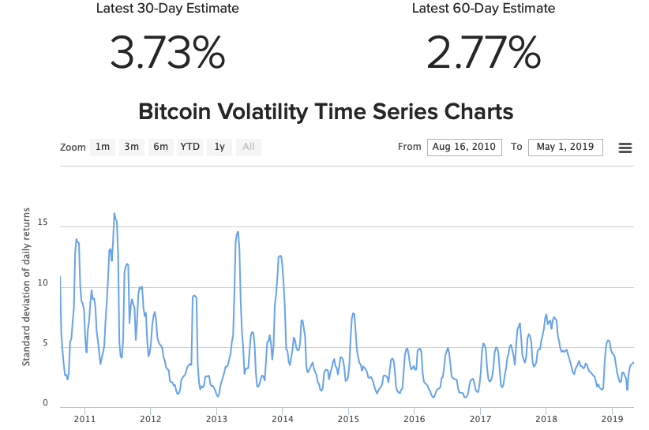
Purpose
01

Slide 5
Purpose
01
Bitcoin‘s price volatility is great.
Returns of time the market is large.
Short at high price, long at low price.

Slide 6
Main idea
01
15%
55%
100%
Simulate trade-related cost
Build up EMA Margin Trade Strategy
Optimise the Strategy and Select the Best Strategy

Slide 7
PART TWO
Specific methods and steps

Slide 8
02
Specific methods and steps
First
We use Volume Weighted Average Price(VWAP) trading strategy to simulate the trade-related cost.
The evaluation indicators include the pecentage of trade-related cost.

Slide 9
02
Specific methods and steps
First
Download Bitcoin market chart and trade history data
Build Polinomial Linear Model with train data
Calculate the Pecentage of Trade-related Cost
Trade with Model
Download Data
Process Data
Build Model
Calculate Cost
Index, fill, split, random select start time. Train and test dataset.
Trade with the Model with test data

Slide 10
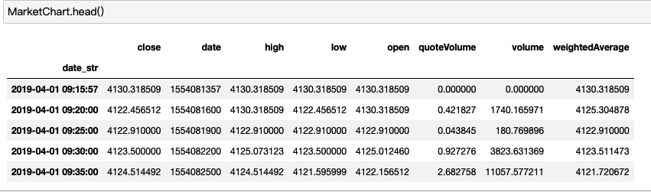
02
Specific methods and steps
Download Data

Slide 11
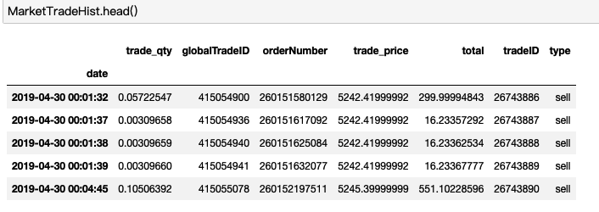
02
Specific methods and steps
Download Data

Slide 12
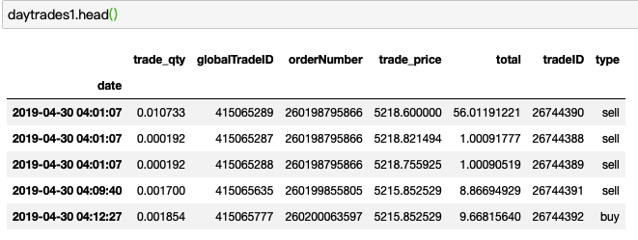
02
Specific methods and steps
Process Data

Slide 13
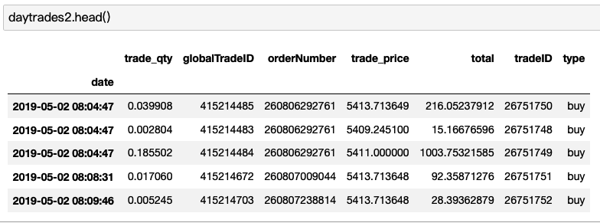
02
Specific methods and steps
Process Data

Slide 14
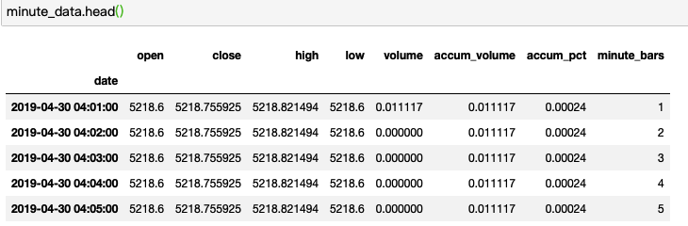
02
Specific methods and steps
Process Data

Slide 15
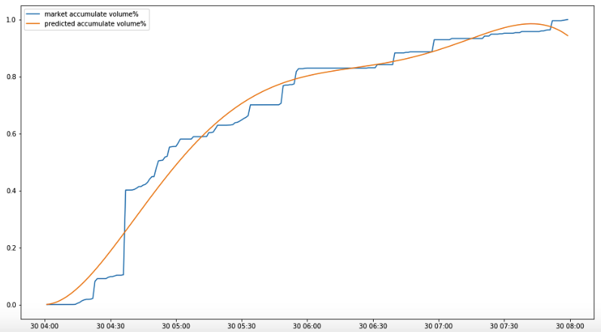
02
Specific methods and steps
Build the Model

Slide 16
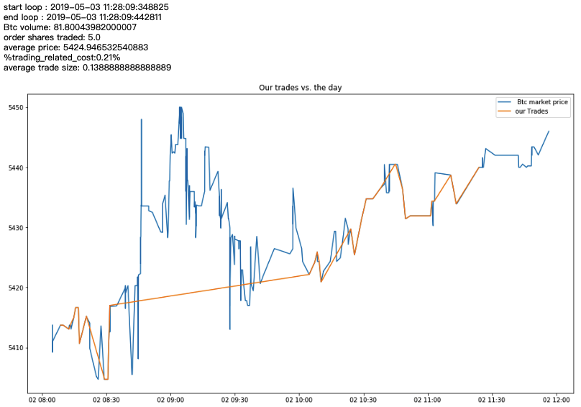
02
Specific methods and steps
Trade with Model

Slide 17
Second
02
Specific methods and steps
Analyse the difference between Bitcoin price and Exponential Moving Average(EMA) price to find the boundary of abnormal high and abnormal low price. Short in abnormal high price and long in abnormal low price.
The calculated indicators of the model include:
ema
diff_pct_close_vs_ema
diff_pct_close_vs_ema_negative_abnormal
diff_pct_close_vs_ema_positive_abnormal

Slide 18
02
Specific methods and steps
Second
Long at Long signal, Short at Short signal, Including Trade Cost
Calculate Exponential Moving Average(EMA)
Abnormal is mean +- 3*standard deviation
Calculate %Pice vs EMA
Trade with Signal
Calculate EMA
Define Abnormal
Build Signal
Calculate pecentage of Price vs EMA
Long signal at Negtive Abnormal, Short signal at Positive Abnormal

Slide 19
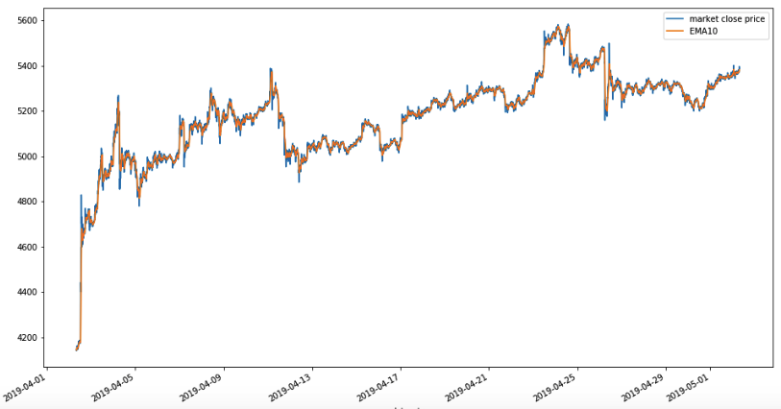
02
Specific methods and steps
Calculate EMA

Slide 20
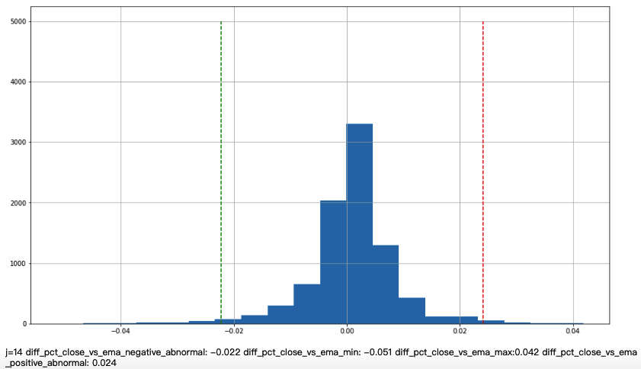
02
Specific methods and steps
Define Abnormal

Slide 21
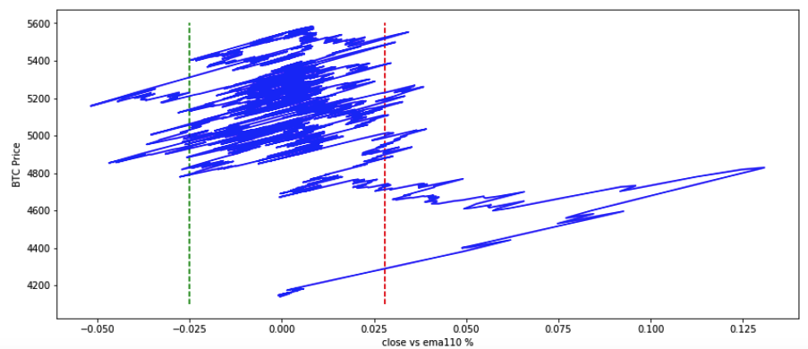
02
Specific methods and steps
Define Abnormal

Slide 22
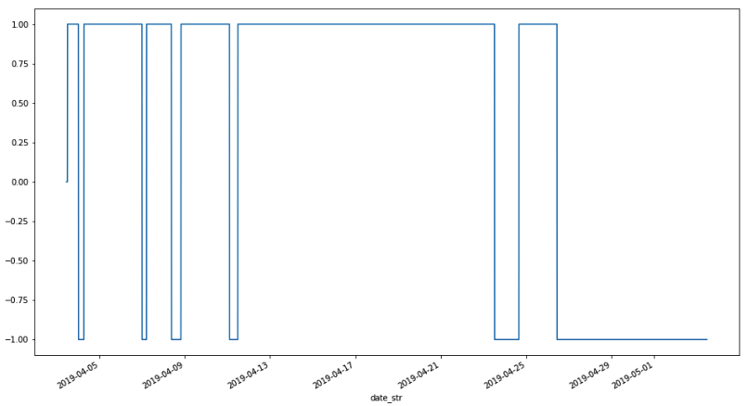
02
Specific methods and steps
Build Signal

Slide 23
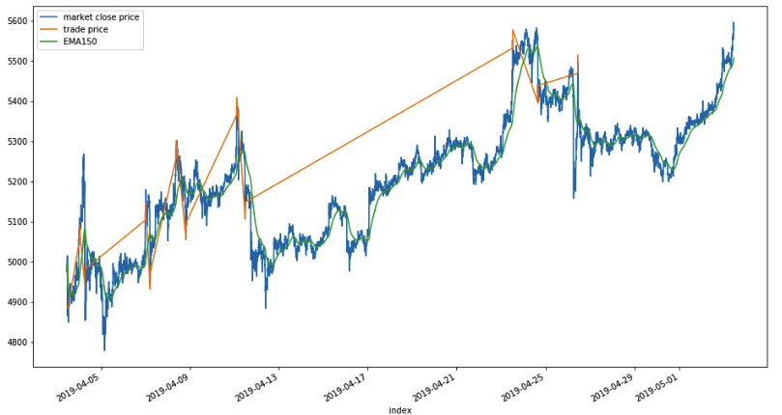
02
Specific methods and steps
Trade with Signal

Slide 24
02
Specific methods and steps
Third
Select multiple span of EMA, execute the strategy many times. Find the optimised stragegy that has the maxmum sharpe ratio and high winning rate.
The evaluation indicators of the model include:
winning rate
annual return
annual standard deviation
annual sharpe ratio

Slide 25
02
Specific methods and steps
Third
Select Multiple Span of EMA, Calculate Multiple EMA
Calculate Sharpe and Winning Rate
Select Multiple Span
Execute Strategy with EMAs
Calculate Indicators
Find the Best EMA
Execute Strategy with different EMAs
Find the Best EMA with Max Sharpe and high Winning Rate

Slide 26
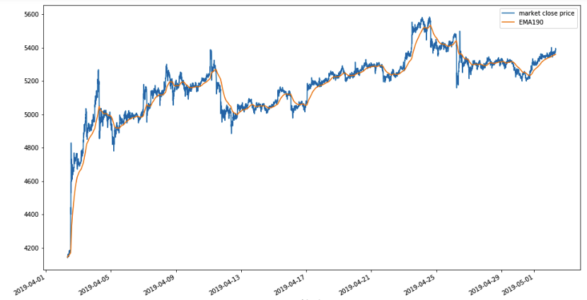
02
Specific methods and steps
Select Multiple Span

Slide 27

02
Specific methods and steps
Find the Best EMA

Slide 28
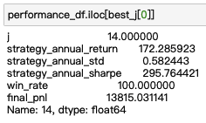
02
Specific methods and steps
Find the Best EMA

Slide 29
PART THREE
The final result

Slide 30
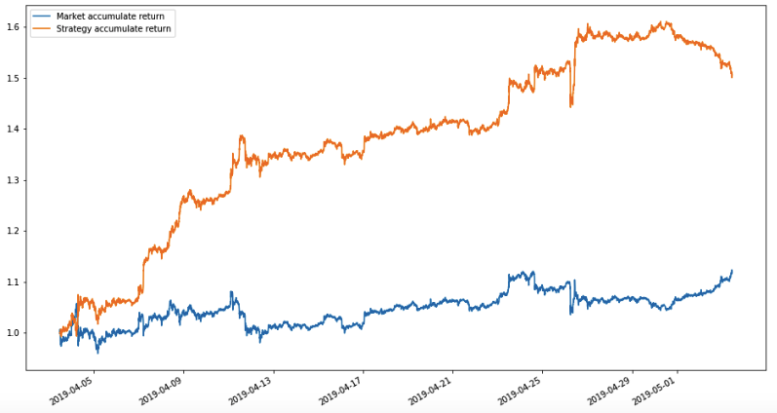
03
Final result
Accumulated Return Curve

Slide 31
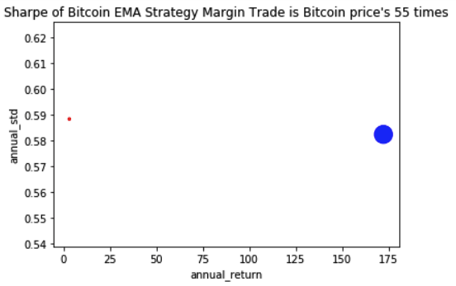
03
Final result
High Return Low risk

Slide 32
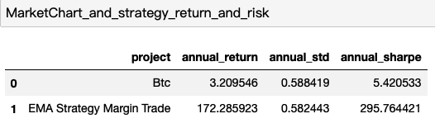
03
Final result
High Return Low risk

Slide 33
03
The final result
100
Best Span:150
75
Annual return:172
50
25
Winning Rate:100%
0

Slide 34
Thanks

